Slide 1
EE451: High Voltage Engineering
Lecture 12

Slide 2
Outline
Breakdown Mechanism in Solid Dielectrics
Introduction
Intrinsic breakdown
Electromechanical breakdown
Thermal breakdown
Breakdown due to treeing and tracking
Breakdown due to internal discharges
Page 2

Slide 3





Introduction
Solid insulating materials are used almost in all electrical equipments to provide insulation between live part of the system and ground.
Solid insulating materials are classified into two categories:
Organic materials (paper, cotton, pressboard, wood and rubber etc.)
Inorganic materials (mica, porcelain, glass, and synthetic polymers such as PVC, epoxy resin, perspex etc.)
Solid dielectric should possess following properties:
Low dielectric loss
High mechanical strength
Free from gaseous inclusions and moisture
Resistant to thermal and chemical deterioration
Page 3

Slide 4
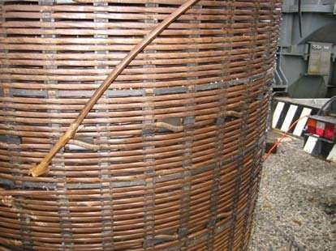
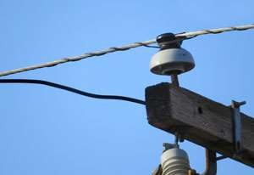
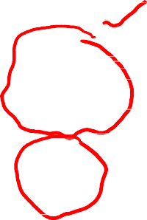

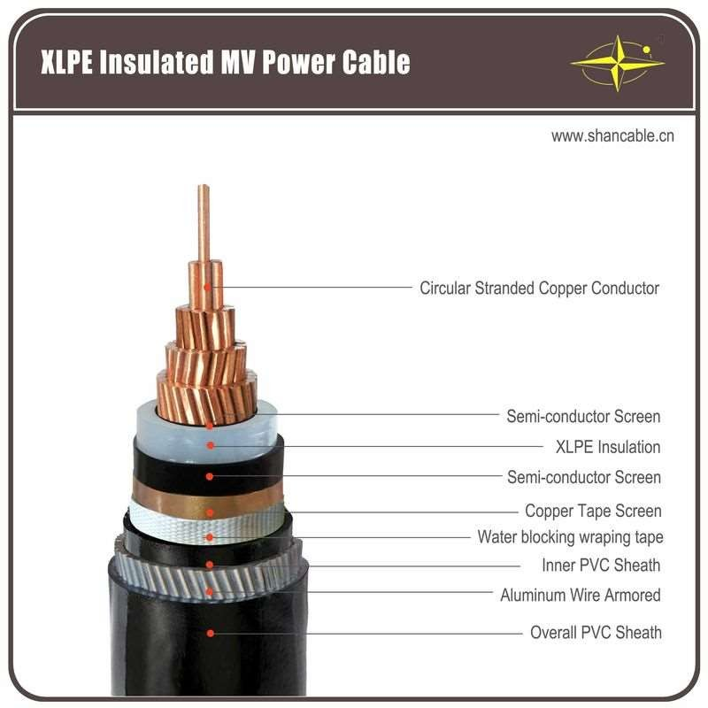




Introduction
Page 4

Slide 5


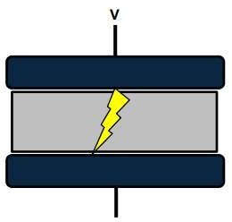


Introduction
If the voltage is steadily increased over a sample, it comes to a point where the dielectric insulating barrier properties are exceeded. A short-circuited breakdown channel is formed.
The maximum electric field stress which a dielectric material can withstand without breakdown is called dielectric breakdown strength (or withstand voltage), and is measured in kV/mm.
When breakdown occurs, solids get permanently damaged while gases fully and liquids partly recover their dielectric strength after the applied electric field is removed.
Several mechanisms can cause electrical breakdown of solid dielectric.
Page 5

Slide 6



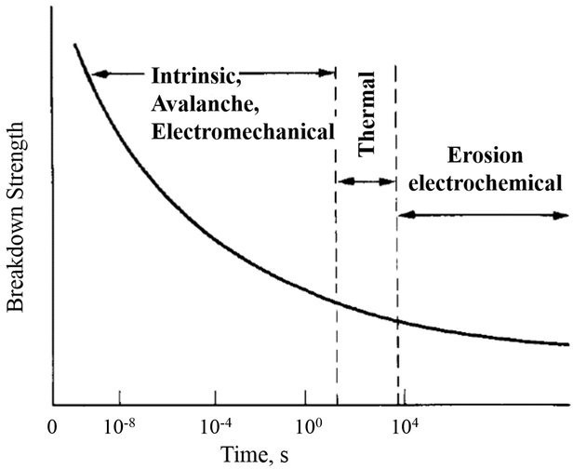





Introduction
In solids, the mechanism of breakdown is a complex phenomena it depends upon the magnitude of voltage applied and time for which the voltage is applied.
The breakdown voltage is related to the time required for breakdown as:
The various breakdown mechanisms can be classified as follows:
Intrinsic or ionic breakdown
Electromechanical breakdown
Thermal breakdown
Breakdown due to treeing and tracking
Breakdown due to internal discharges
Electrochemical breakdown
Page 6

Slide 7

Intrinsic Breakdown
The intrinsic strength of a material is the measure of the highest voltage it can withstand without causing breakdown under controlled conditions.
Experimentally, this highest dielectric strength can be obtained only if the dielectric material is pure and homogeneous, the temperature and environmental conditions suitably controlled.
A breakdown taking place under such conditions is referred as intrinsic breakdown.
Thus, an important factor in measuring the intrinsic strength in the laboratory is the thickness of dielectric between the electrodes and electrode symmetry.
The usual practice is the use of uniform field electrodes of Rogowski profile.
The stress required to produce intrinsic breakdown is of the order of 1 MV/cm whereas the time in which it occurs is of the order of 10⁻⁸ seconds.
Page 7

Slide 8


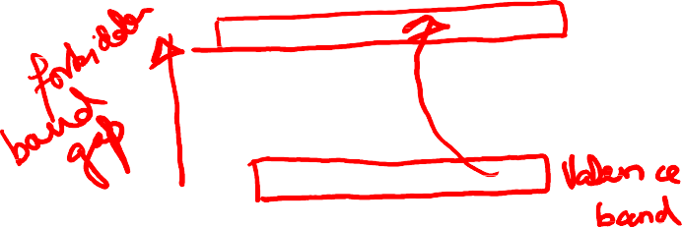
Intrinsic Breakdown
The intrinsic breakdown is classified into two types:
Electronic breakdown
Avalanche or streamer breakdown
Electronic breakdown is mainly based on energy-band model of solid-state physics.
Since, the intrinsic strength develops very rapidly, the intrinsic breakdown is assumed to be electronic in nature.
The presence of free electrons is responsible for the breakdown of solid dielectric. These electrons present in the solid dielectric will gain sufficient energy from the applied field to cross the forbidden gap from valence band to conduction band.
When this process proceeds continuously, more and more electrons enter into the conduction band and eventually, it leads to the breakdown.
Page 8

Slide 9
Intrinsic Breakdown
Avalanche breakdown is similar to breakdown in gases due to cumulative ionization.
Under the influence of applied field, these electrons along with the already present electrons make ionization collisions, resulting in the multiplication of electrons.
When electrons are liberated from neighbouring atoms, the result is the formation of positive ions, which are fixed in the lattice.
Thus, the electrons are reach the anode and get absorbed, leaving behind a trial of positive ions along the path the ionization.
This produces a low resistive path between the electrodes, thereby resulting in a short circuit.
Page 9

Slide 10
Intrinsic Breakdown
It should be remembered that in case of solid dielectric, the short circuit will cause burning of path along the positive ions trails.
This leaves a permanently conducting path through carbonization and makes the dielectric unfit for future use for insulating purposes.
Page 10

Slide 11
Electromechanical Breakdown
According to electromechanical breakdown, the insulation may fail when the applied electric stress exceeds its mechanical strength.
When solid dielectrics are subjected to high electric fields, charges of opposite nature are induced on the two opposite surfaces of the material.
Hence, a force of attraction is developed and the test specimen is subjected to electrostatic compressive forces.
When these forces exceed the mechanical withstand strength of the material, the breakdown of material occurs.

Slide 12




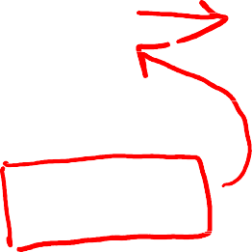



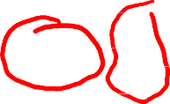
Electromechanical Breakdown
If the thickness of the specimen is d₀ and is compressed to a thickness d under an applied voltage V, then the electrically developed compressive stress is in equilibrium if
where Y is the Young's modulus. Thus,
Usually, mechanical instability occurs when
The highest apparent electric stress before breakdown,

Slide 13

Thermal Breakdown
When an insulating material is subjected to an electric field, the material gets heated up due to conduction current and dielectric losses due to polarization.
The conductivity of the material increases with increase in temperature and a condition of instability is reached when the heat generated exceeds the heat dissipated by the material and the breakdown of material occurs.
Under d.c field, the heat generated is given as:
where σ = d.c conductivity of the specimen.
E = electric field intensity

Slide 14
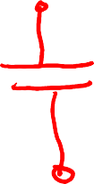
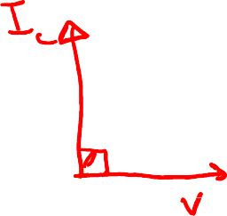


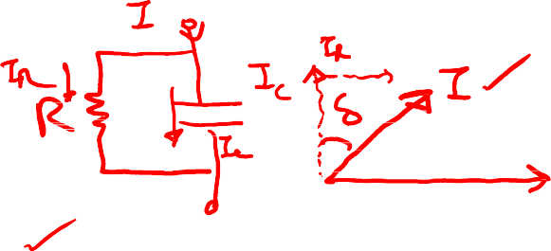


Thermal Breakdown
Under a.c field, the heat generated is,
where f = frequency of supply voltage
δ = loss angle of the dielectric material
E= rms value of electric field intensity
The heat dissipated (W_{T}) is given by,
where C_{V} = specific heat of the specimen,
T = temperature of the specimen,
K = thermal conductivity of the specimen, and
t = time over which the heat is dissipated.

Slide 15
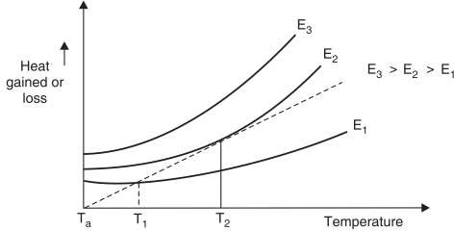

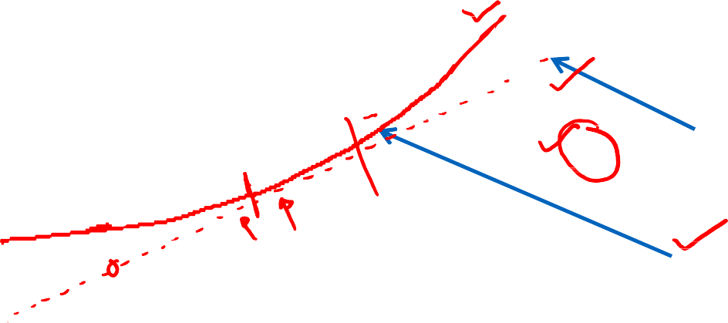
Thermal Breakdown
The breakdown of solid dielectric occurs when the heat generated exceeds the heat dissipated.
Heat Lost
Heat Generated

Slide 16

Breakdown due to Treeing and Tracking
When a solid dielectric subjected to electrical stresses for a long time fails, normally two kinds of visible markings are observed on the dielectric materials. They are:
the presence of a conducting path across the surface of the insulation;
a mechanism whereby leakage current passes through the conducting path finally leading to the formation of a spark. Insulation deterioration occurs as a result of these sparks.
The spreading of spark channels during tracking, in the form of the branches of a tree is called treeing.

Slide 17
Breakdown due to Treeing and Tracking
Consider a system of a solid dielectric having a conducting film and two electrodes on its surface.
Some contaminants in the form of moisture or dust particles will get deposited on the surface of the insulation and form a conducting film.
The leakage current starts to flow through the conducting film between the electrodes.
The current heats the moisture and the conducting film separates due to drying. These small films then act as electrodes and sparks are initiated between the films.
The sparks cause carbonization and volatilization of the insulation and lead to formation of permanent carbon tracks on the surface of insulation.

Slide 18
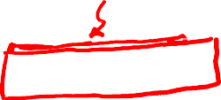
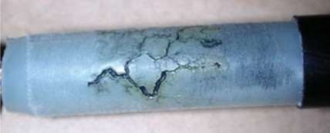

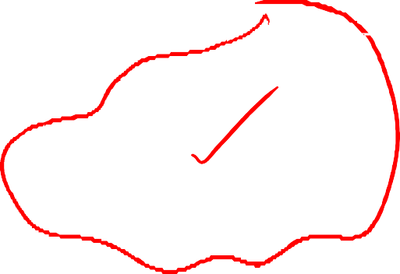
Breakdown due to Treeing and Tracking
Therefore, tracking is the formation of a permanent conducting path (usually carbon) across the surface of insulation.
This is a cumulative process, and insulation failure occurs when carbonized tracks bridge the distance between the electrodes.

Slide 19
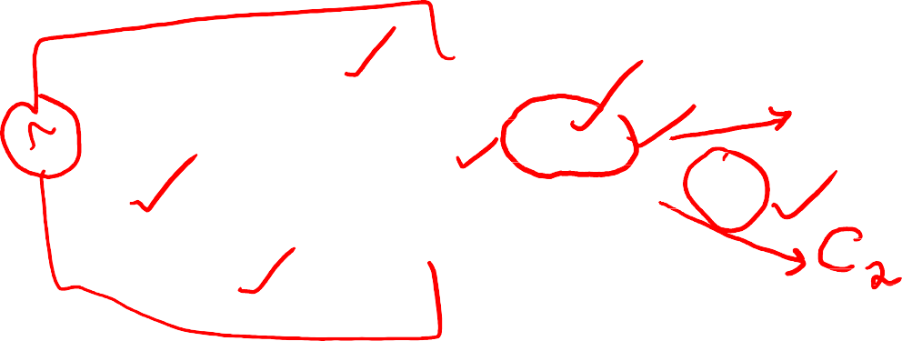
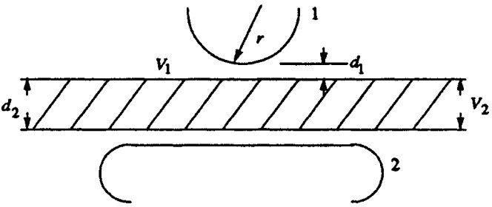

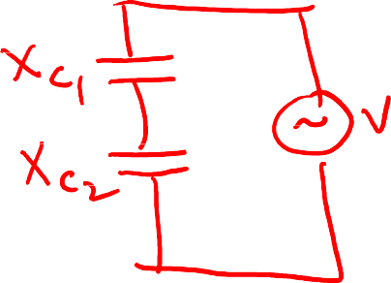
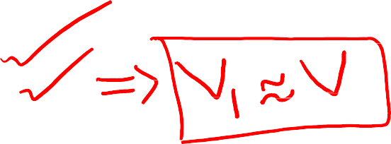

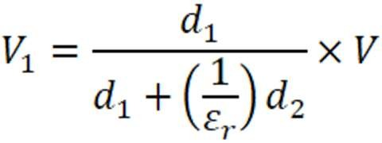


Breakdown due to Treeing and Tracking
When a solid dielectric is placed between the two electrodes, there is a high possibility that two different dielectric media, the air and the dielectric, to come in series.
The voltage across the air gap, V₁, is given by,
Since ε_{r} > 1, most of the voltage appears across the air gap. Consequently, the air gap breaks down at a relatively lower voltage.

Slide 20





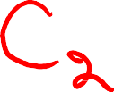












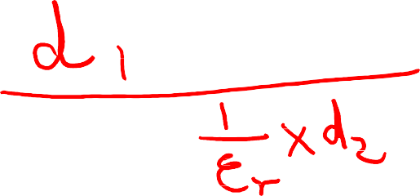



Slide 21
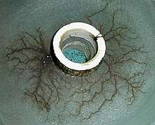
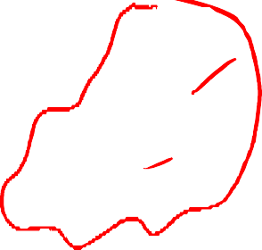
Breakdown due to Treeing and Tracking
The charge concentration in such voids is found to be quite large to give fields of the order of 10 MV/cm which is higher than even the intrinsic breakdown.
Thus, sparking will occur in the air gap and, charge accumulation takes place on the surface of the insulation. The spark may erode the surface of the insulation.
As time passes, breakdown channels spread through the insulation in an irregular tree like fashion.
This will lead to the formation of permanent conducting channels called treeing.
Page 21

Slide 22
Breakdown due to Treeing and Tracking
Positive ions are formed due to ionisation by collision or by photo-ionisation, and
being positively charged, they travel towards the cathode.
A positive ion approaching a metallic cathode can cause emission of electrons from the cathode by giving up its kinetic energy on impact.
If the total energy of the positive ion, namely, the sum of its kinetic energy and the ionisation energy, is greater than twice the work function of the metal, then one electron will be ejected and a second electron will neutralise the ion.
The electron emission by positive ion is the principal secondary process in the Townsend spark discharge mechanism

Slide 23
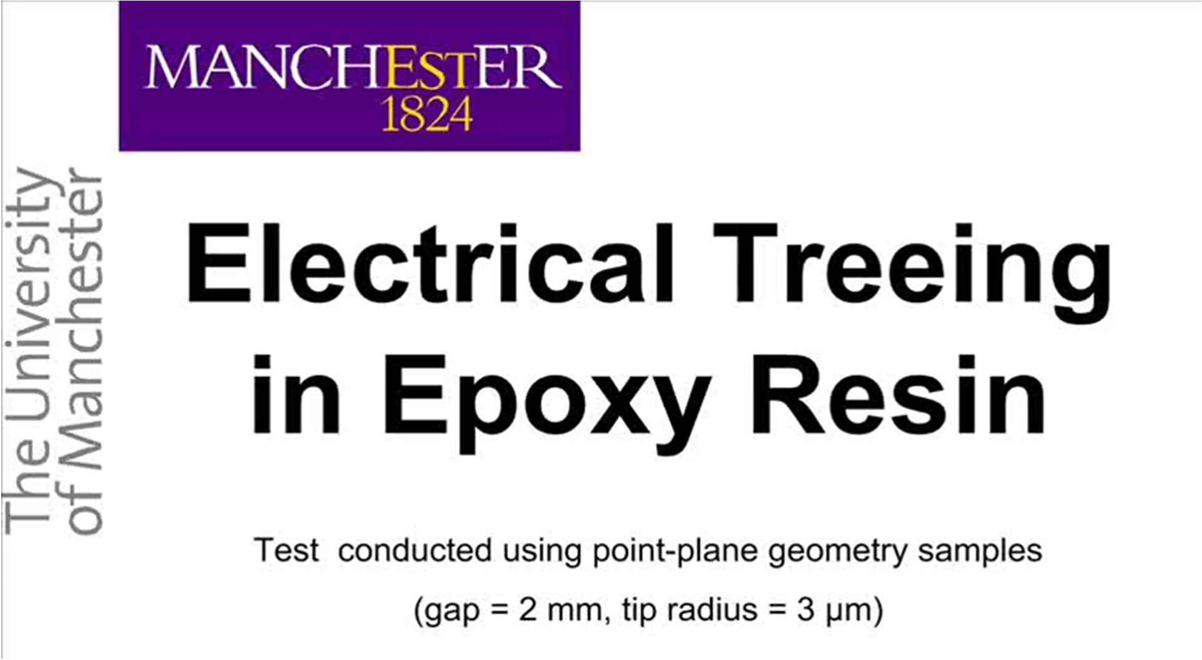
Breakdown due to Treeing and Tracking

Slide 24
Breakdown due to Internal Discharges
Solid insulating materials may contain voids or cavities within the medium or at the
boundaries between the dielectric and the electrodes.
These voids are generally filled with a medium of lower dielectric strength, and the dielectric constant of the medium in voids is lower than that of the insulation.
Hence, the electric field strength in the voids is higher than that across the dielectric.
Under normal applied voltage, the field in the voids may exceed their breakdown value, and breakdown may occur.

Slide 25
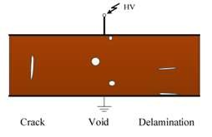

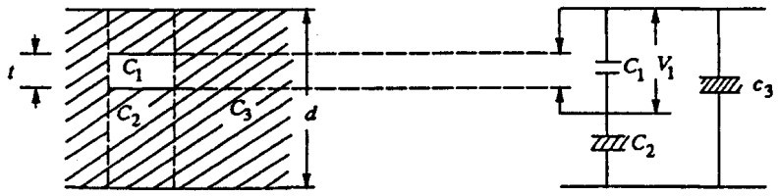





Breakdown due to Internal Discharges
Let us consider a dielectric between two electrodes as shown in figure. Suppose that the insulation is divided into three parts, an electrical network of C₁, C₂, and C₃ can be formed as shown below.

Slide 26
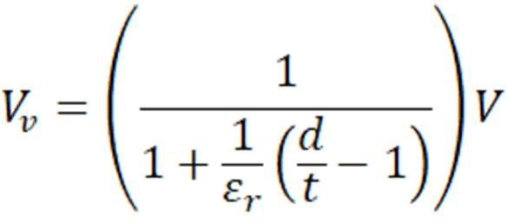
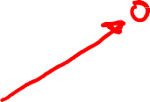


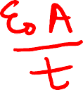




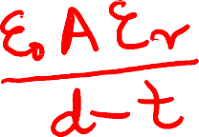
Breakdown due to Internal Discharges
Let C₁ = capacitance of the void or cavity,
C₂ = capacitance of the dielectric which is in series with the void
C₃ = capacitance of the rest of the dielectric.
When the applied voltage is V, the voltage across the void V_{v} is given by,
Since ε_{r} > 1, the stress in the void will exceed that in the solid and the breakdown of the gas in the void will take place.

Slide 27
Breakdown due to Internal Discharges
When a voltage V is applied, V₁ reaches the breakdown strength of the medium in the cavity (V_{i}) and breakdown occurs. V_{i} is called the discharge inception voltage.
When the applied voltage is a.c., breakdown occurs on both the half cycles and the number of discharges will depend on the applied voltage.
The voltage and the discharge current waveforms are shown in figure. When the first breakdown across the cavity occurs the breakdown voltage across it becomes zero.
When once the voltage V₁ becomes zero, the spark gets extinguished and again the voltage rises till breakdown occurs again.
This process repeats again and again, and current pulses as shown, will be obtained both in the positive and negative half cycles.

Slide 28
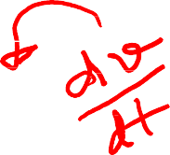



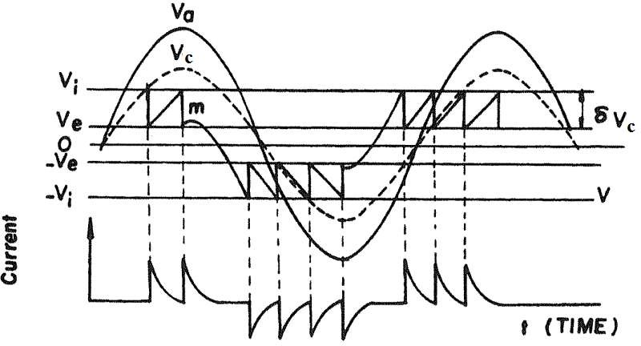

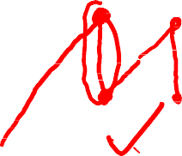

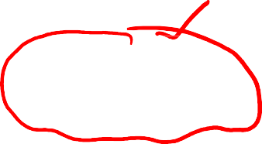
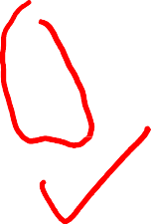

Breakdown due to Internal Discharges

Slide 29
Breakdown due to Internal Discharges
These internal discharges (also called partial discharges) will have the same effect as "treeing" on the insulation.
These internal discharges may result into following:
High temperature in the region of discharges, and this will carbonize the surface of the voids and will cause erosion of the material.
Channels and pits formed on the cavity surfaces increase the conduction.
Chemical degradation may also occur as a result of the internal discharge products formed during breakdown.

Slide 30
Breakdown due to Internal Discharges
When the breakdown occurs in the voids, electrons and positive ions are formed. They will have sufficient energy to break the chemical bonds of the insulating material at the void surfaces.
All these effects will result in a gradual erosion of the material and consequent reduction in the thickness of insulation leading to breakdown.
The life of the insulation with internal discharges depends upon the applied voltage and the number of discharges.
Breakdown by this process may occur in a few days or may take a few years.
Page 30

Slide 31
Electrochemical Breakdown
In the presence of air or other gases, some dielectric materials undergo chemical changes when subjected to continuous electric stresses.
Some of the common chemical reactions are:
Oxidation
Hydrolysis etc
The chemical reactions result in:
Surface cracks
Reduction in electrical and mechanical strength
Reduction in lifetime
Page 31

Slide 32
THANK YOU FOR YOUR ATTENTION

